Slide 1
Topics To be Covered ..!!
Aditya Nair :- Role of System Analyst
Nikhil Lathiya :- Feasibility Study
Misti Pawar :- Preliminary Investigation
Grusha Hadiyal :- Institutional User
Sheetal Matang :- End User Application

Slide 2

Role
Of
System
Analyst
By Aditya Nair

Slide 3
Defining
I.T.
Requirements
Of The
Company
1
By Aditya Nair

Slide 4

To understand the user's requirements is one of the most important and difficult duties of an analyst.
And for that they use several fact-finding techniques like interview, questionnaire, and observation, etc.
By Aditya Nair

Slide 5
Setting
Priority Among Requirements
2
By Aditya Nair

Slide 6
After collecting information about what the company requires, it becomes responsibility of the analyst to arrange the gathered requirements according to priority from highest to lowest in order to design an effective system.
By Aditya Nair

Slide 7
Gathering
Data
&
Facts
3
By Aditya Nair

Slide 8
System analyst gathers facts and information required for the formulation of the system.
For an Analyst Data and fact gathering is important step, on which he/she can develop better understanding of existing system and its problems, based on this analyst can understand the requirements of new system.
By Aditya Nair

Slide 9
Analyzing
Problems
4
By Aditya Nair

Slide 10
A Systems Analyst is basically a problem solver. It is a must that he study the problem in depth and suggest alternate solutions to management.
By Aditya Nair

Slide 11
Problem
Solving
5
By Aditya Nair

Slide 12
After analyzing the problem , the very next duty of the analyst is to take necessary steps to solve the problem.
If the problems and errors are not solved then the system if likely to malfunction/fail.
By Aditya Nair

Slide 13
Management
6
By Aditya Nair

Slide 14
Management is one of the main skill a system analyst should possess. After planning and designing the analyst should be able to manage several things like time, project , man-power etc. in order to bring the system into action.
By Aditya Nair

Slide 15
Adaptability
7
By Aditya Nair

Slide 16
The working environment changes from company to company or sometimes the environment inside the company also changes adversely. In such cases the analyst should be able to settle down with the circumstances and handle the situation wisely.
By Aditya Nair

Slide 17
Feasibility study
By : Nikhil Lathiya
Let the Presentation Begin

Slide 18

System Analysis and Design
What is Feasibility Study ?
Types of Feasibility Study
Importance of Feasibility Study
—Nikhil Lathiya

Slide 19
What is Feasibility Study ??
As the name suggests , feasibility study is a study to reveal whether
a project is feasible (possible to do) or not.
It is conducted in order to find answers to the following questions :
Do we have required resources and technologies to built the project
Do we receive profit from the project
It tells us weather a project is worth the investment
After the feasibility study the project may be accepted , accepted
with modification or rejected .
—Nikhil Lathiya

Slide 20

Types of Feasibility Study
—Nikhil Lathiya

Slide 21
There are 5 types of feasibility
04
Operational
Economical
02
05
Scheduling
03
Legal
01
Technical
Whether a company have required technical resources or not
Whether the project setisfies the requirement
Cost and benefit of the project is analyzed
Necessary Time to complete the project
Whether the Project is legal or not
—Nikhil Lathiya

Slide 22

01
Technical Feasibility
—Nikhil Lathiya

Slide 23

Technical Feasibility
In technical feasibility , we check whether we have required technical resources (like hardware and software) to develop the project
—Nikhil Lathiya

Slide 24

Technical Feasibility
This feasibility study also analyzes technical skills and capabilities of technical team , existing technologies can be used or not , maintenance and up-gradation is easy or not for chosen technologies etc.
—Nikhil Lathiya

Slide 25
02
Economical Feasibility
—Nikhil Lathiya

Slide 26
Economical Feasibility
In Economical feasibility , cost and benefits of the project is analyzed
In this feasibility study , a detail analysis is carried out to know that what will be the cost of the project including hardware and software resource is required , design and development cost and so on.
It is also analyzed whether project will be beneficial for organization or not.
—Nikhil Lathiya

Slide 27
03
Legal Feasibility
—Nikhil Lathiya

Slide 28

Legal Feasibility
In legal Feasibility study we investigate whether the project is legal or not
—Nikhil Lathiya

Slide 29
Operational Feasibility
04
—Nikhil Lathiya

Slide 30

Operational Feasibility
In Operational Feasibility Study we , examine whether the project satisfies the requirements identified in the requirement analysis phase
—Nikhil Lathiya

Slide 31
Scheduling Feasibility
05
—Nikhil Lathiya

Slide 32

Scheduling Feasibility
In scheduling Feasibility study, we estimate the time necessary to complete the project.
We also consider the organization’s capabilities and determine whether that amount of time is available or not .
—Nikhil Lathiya

Slide 33
Importance of Feasibility
—Nikhil Lathiya

Slide 34
Importance of Feasibility
Get a clear – cut idea of weather the project is likely to be successful , before allocating budget , manpower and time.
Improves project team’s focus
Provides valuable information for a “go/no-go” decision
Identifies a valid reason to undertake the project
Diagonoses error and aids in troubleshooting them
Enhances the success rate by evaluting multiple parameters
—Nikhil Lathiya

Slide 35













Preliminary Investigation

Slide 36


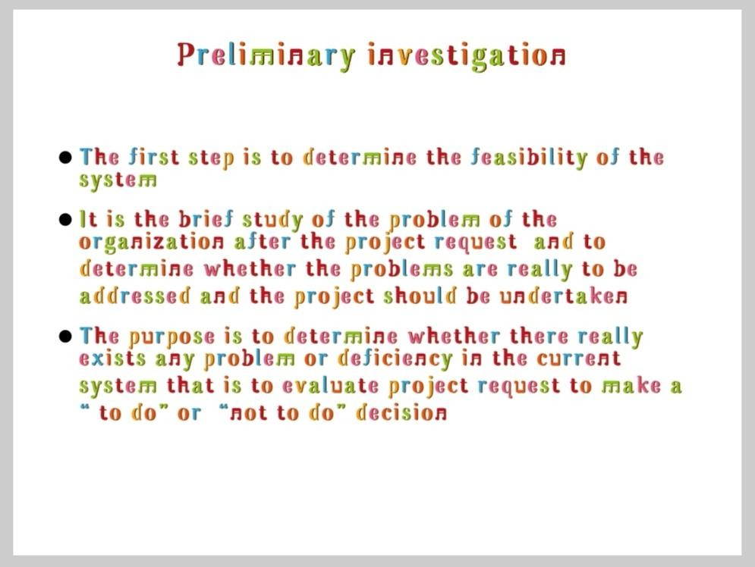


What is Preliminary Investigation...?

Slide 37
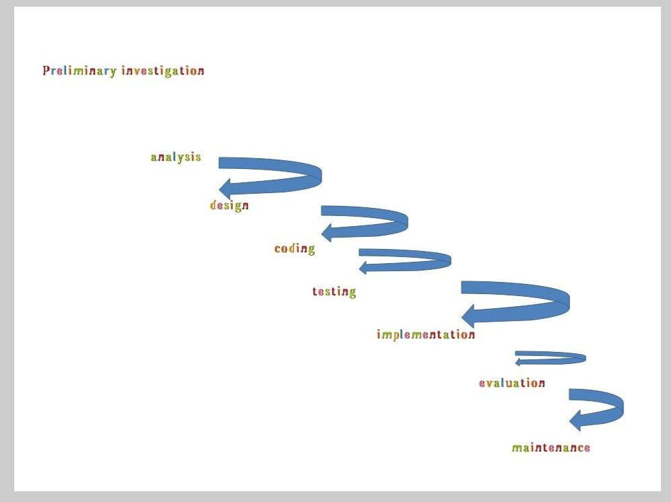






Diagram Of Preliminary Investigation

Slide 38



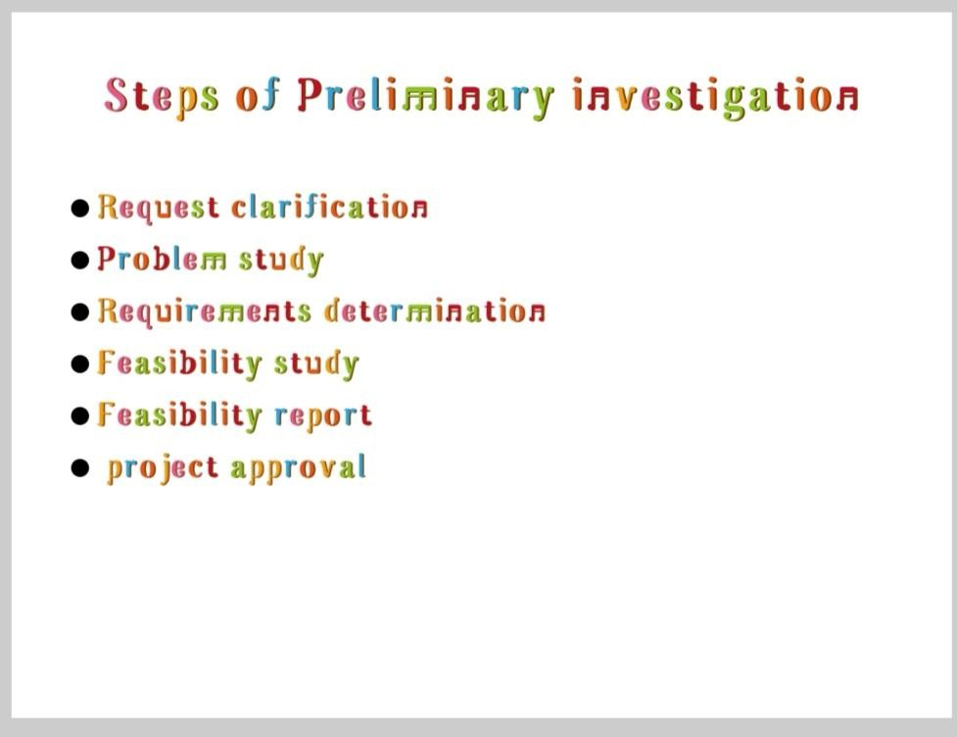



Step Of preliminary investigation.....

Slide 39



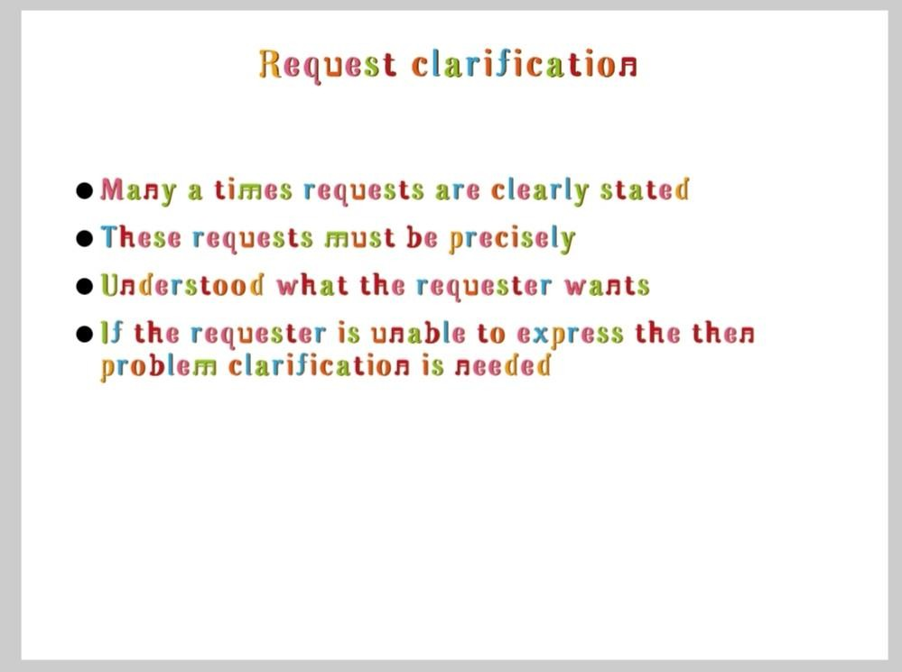



1. Request Clarification.....

Slide 40

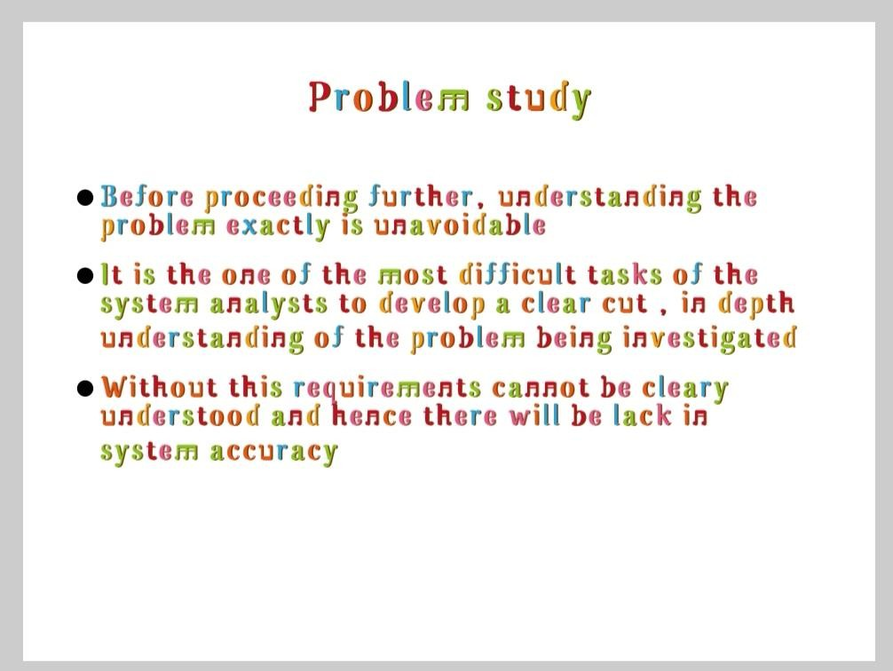


2. Problem study.....

Slide 41



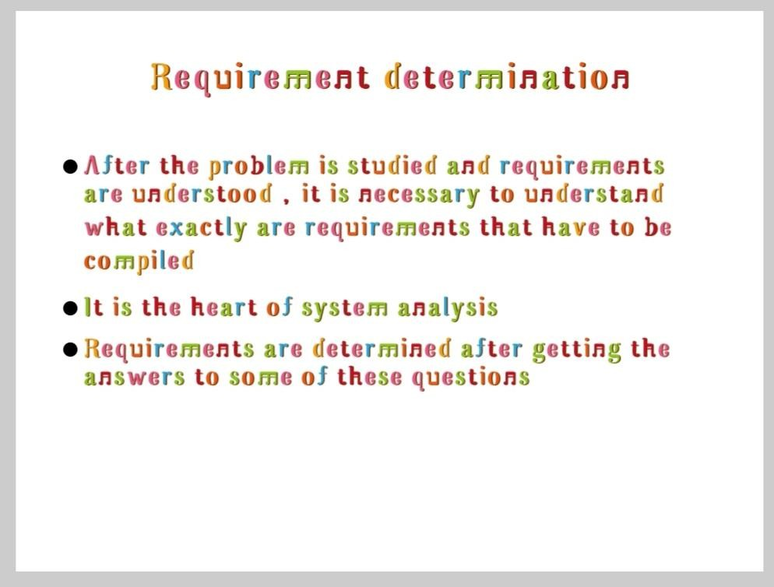

3. Requirements Determination.....

Slide 42
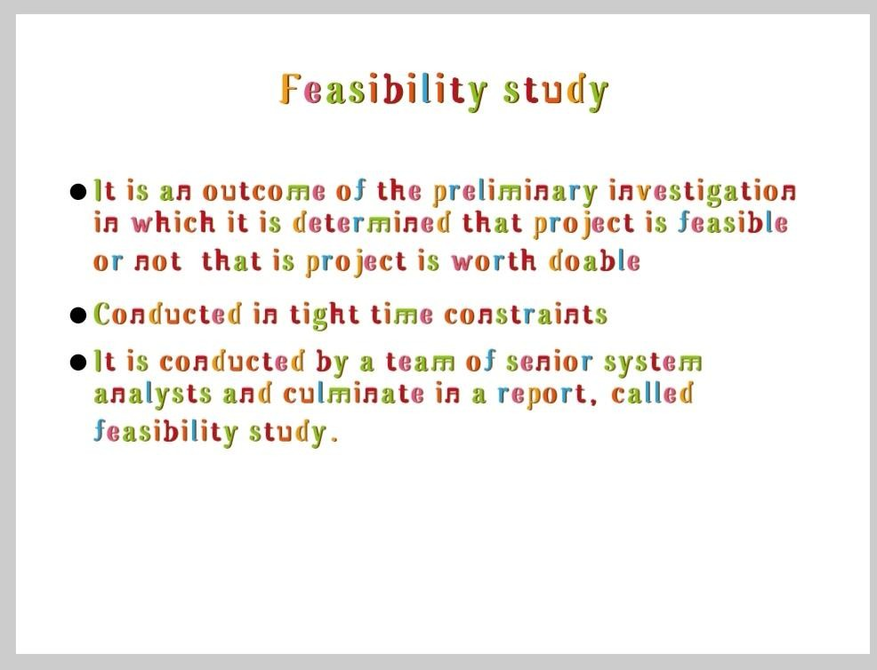

4. Feasibility study......

Slide 43

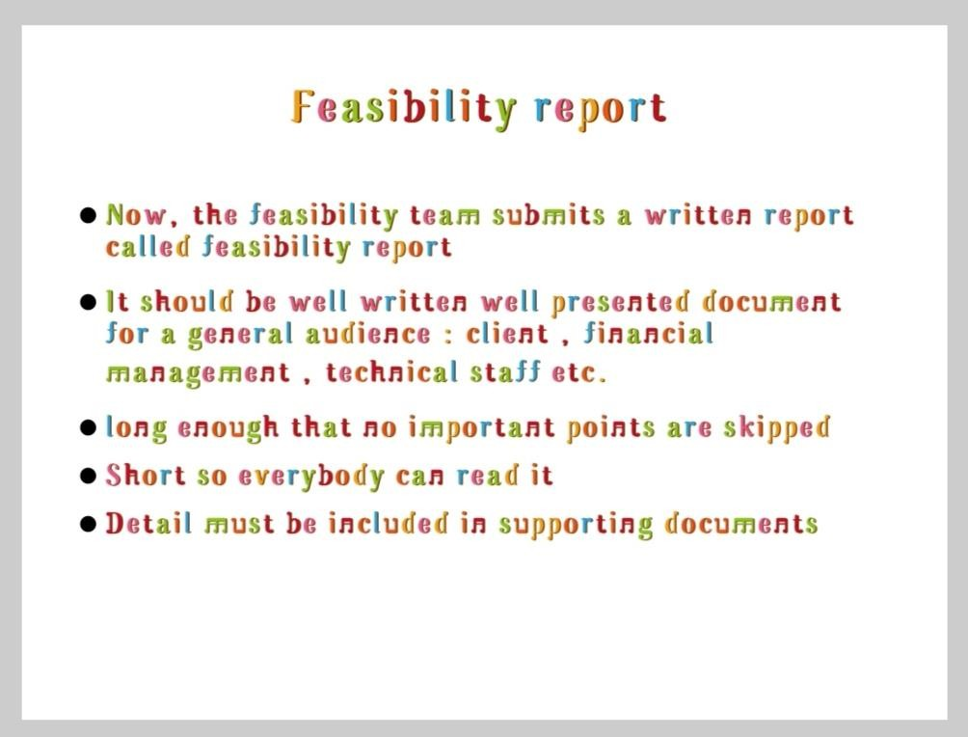




5. Feasibility Report......

Slide 44
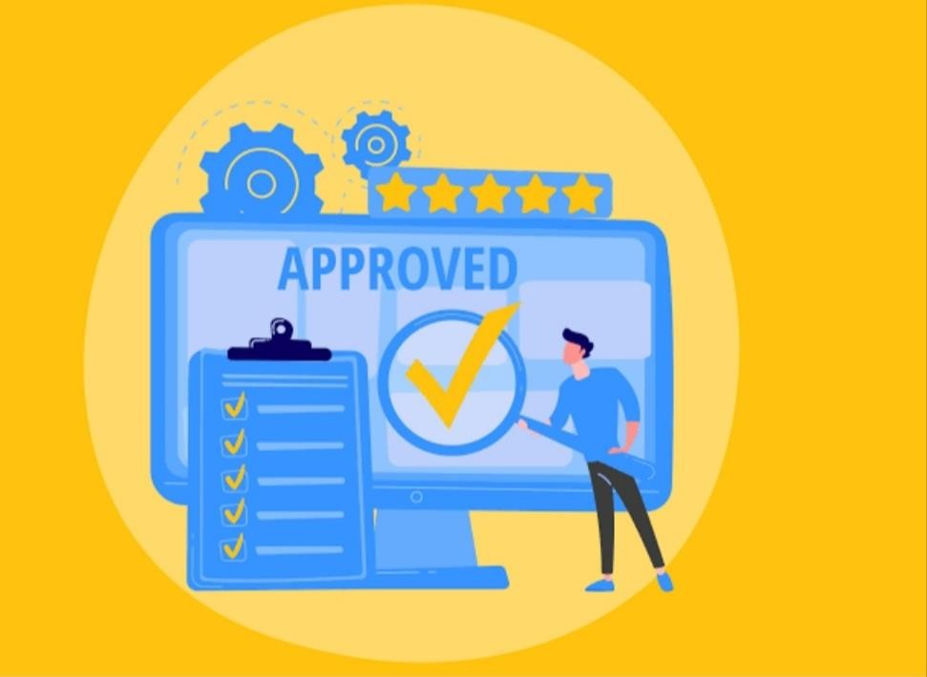
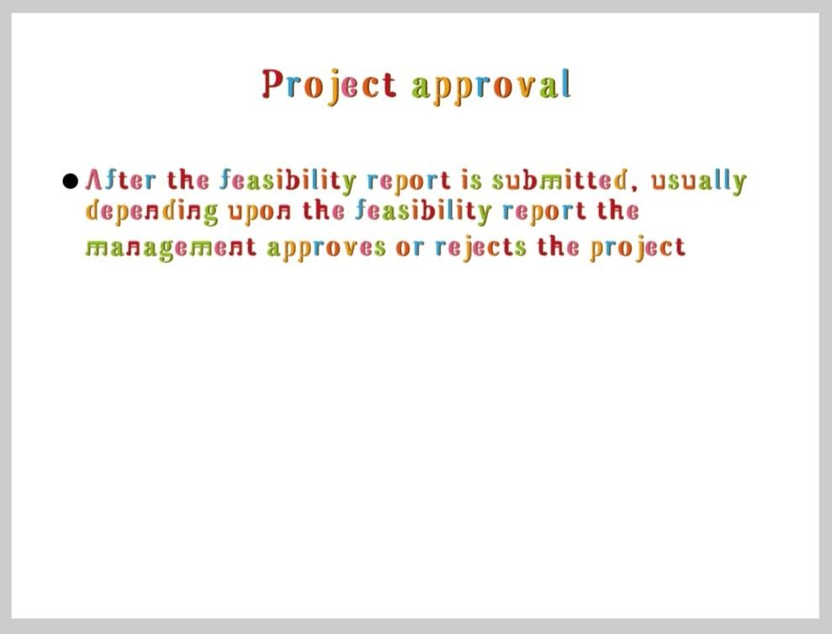



6. Project Approval......

Slide 45

Introduction to institutional user
- Grusha Hadiyal

Slide 46
A institutional user is the person performing the purchasing transaction.
At your place of work, if your boss is the one that went and purchased the computer, then he is the customer.
In larger businesses, there may be a dedicated purchasing representative who makes all the purchases for the company.
That person is also the customer, and everybody in the business using those materials are end users.

Slide 47
In everyday life, the end user and institutional user are often the same person. This is especially true for single people.
If you don't have a family and it's just you, most everything you purchase is ultimately used by you.
So you are both the user and the customer.

Slide 48

Let's understand this concept with example

Slide 49
Example of institutional user
Suppose ,
when principal buys laptops for the staff in school than he will be considered as institutional user while the staff using these laptops will be considered as end users as they are not buying it but they are still using it.

Slide 50

End user application

Slide 51
Introduction
what is end user application.An information system development by and end user developer in order to support him/her in his/her work.

Slide 52
What is end user application software?
An application is any program, or group of program ,that is designed for the end user.
Application software include such things as database program ,word processors, web browser and spreadsheets.

Slide 53
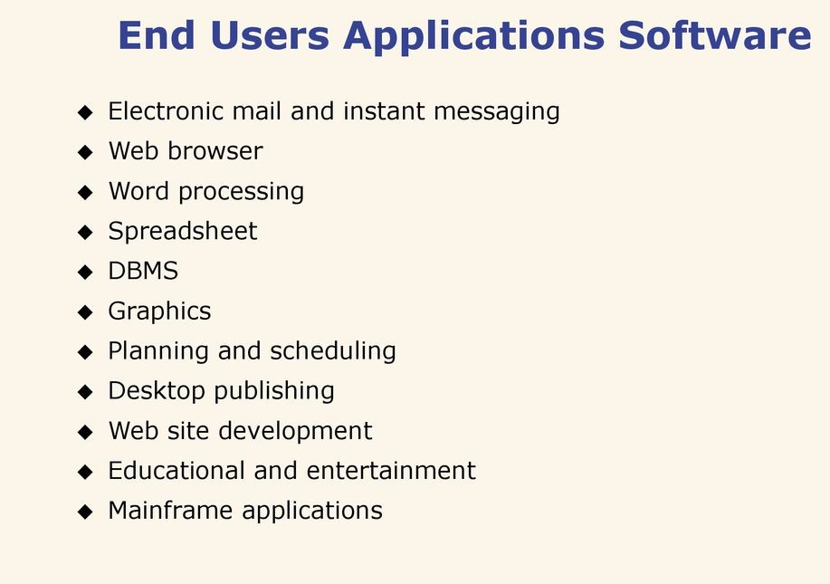

Slide 54
What are end user devices?
An end user devices is a personal computer(laptop or desktop),consumer devices(E.g. personal digital assistant(PDA) ,smart phone)
Or removable storage media (e.g. USB flash drive , memory card, writeable CD or DVD) that can store information.

Slide 55
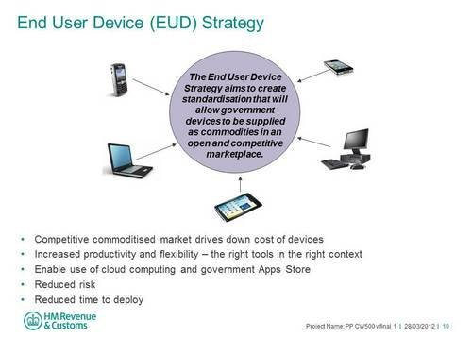

Slide 56
What is an end user account?
End user are special types of accounts that are converted from technician accounts, and have limited access to a number of devices through a special web area.
End user are restricted to the End User area where they can only access devices to which they have been granted permission

Slide 57
What is end user access?
In product development ,an end user is a personal who ultimately uses or is intended to ultimately use a product.
In information technology , end users are not “customer” in the usual sense- they are typically employees of the customer.

Slide 58
Thank You …!!
-> Aditya Nair
-> Nikhil Lathiya
-> Misti Pawar
-> Sheetal Matang
-> Grusha Hadiyal

